Slide 1
Mitron Bank: Analysis for New Credit Card Launch

Slide 2
Objective
To introduce a new line of credit cards, aiming to broaden its product offerings and reach in the financial market
To guide them in tailoring the credit cards to customer needs and market trends.

Slide 3
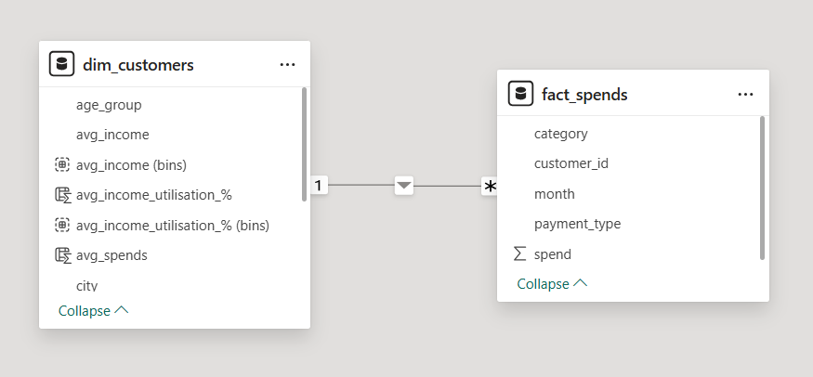
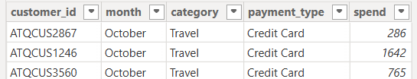
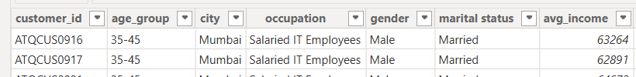
Sample Dataset
They provided a sample dataset of 4000 customers across five cities on their online spending and other details.

Slide 4
Project Requirements
Demographic classification: Classify the customers based on available demography such as age group, gender, occupation etc. and provide insights based on them.
Avg income utilisation %: Find the average income utilisation % of customers (avg_spends/avg_income). This will be your key metric. The higher the average income utilisation %, the more is their likelihood to use credit cards.
Spending Insights: Where do people spend money the most? Does it have any impact due to occupation, gender, city, age etc.? This can help you to add relevant credit card features for specific target groups.
Key Customer Segments: By doing above, you should be able to identify and profile key customer segments that are likely to be the highest-value users of the new credit cards. This includes understanding their demographics, spending behaviours, and financial preferences.
Credit Card Feature Recommendations: Provide recommendations on what key features should be included in the credit card which will improve the likelihood of credit card usage. This should be backed by the insights from data provided and also some secondary research on the internet for this.

Slide 5
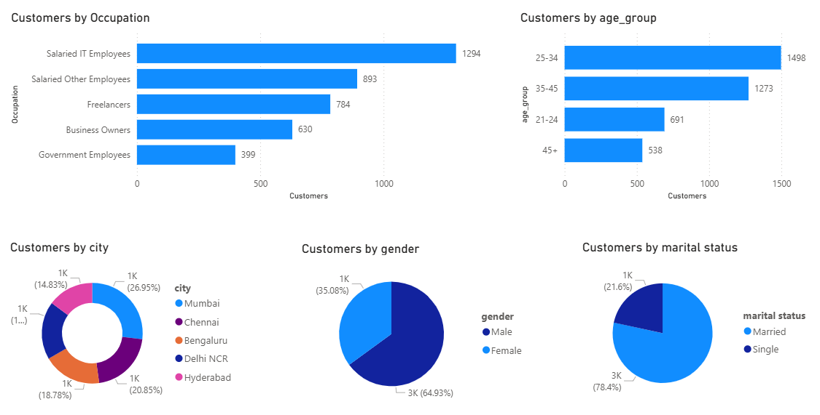
General Customer Demographics

Slide 6
General
Most customers using credit card are IT employees who have average salary between 40k and 70k.
Credit card is mostly used for paying bills. Secondly for electronics.
Most customers are married using credit card mostly for paying bills. Unmarried people use credit cards mostly for electronics.
Most customers in general and using credit card are male.
Most customers live in Mumbai
Age groups of actively credit card using customers are 25-34 and 35-45.
Most expensive month is September

Slide 7
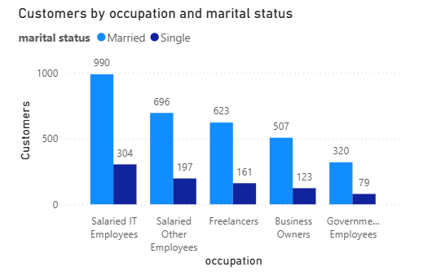
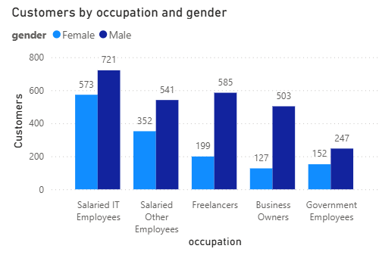
General Customer Demographics

Slide 8
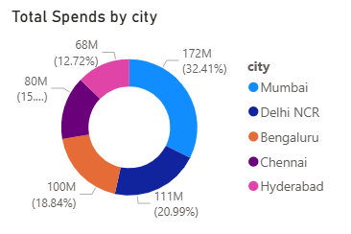
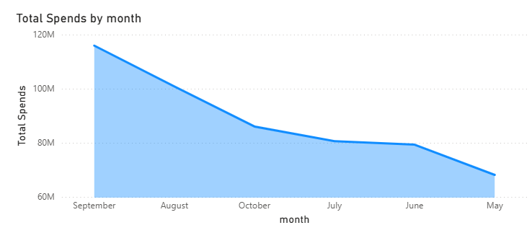
Most customers live in Mumbai
Most expensive month is September

Slide 9
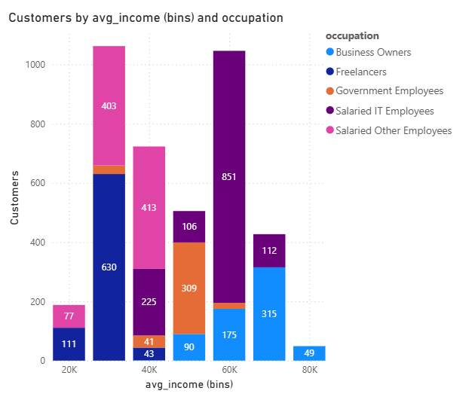
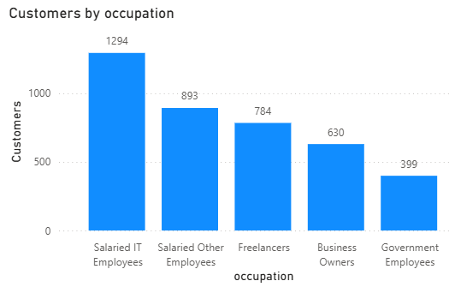
Average Salary & Occupation
Majority of the customers belong to average salary of 30k, 40k and 60k.
Most of them are Salaried IT Employees, Freelancers and Salaried Other Employees.

Slide 10
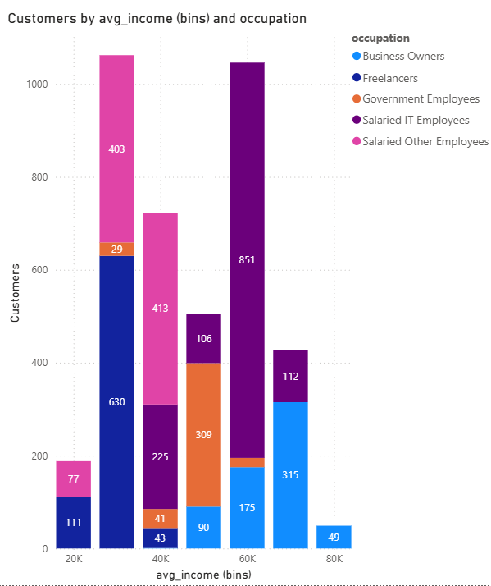
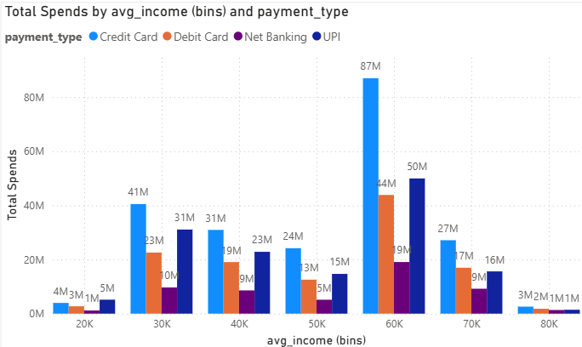
Average Salary & Occupation
Most customers using credit card are IT employees who have average salary between 40k and 70k.
Following credit card usage is by Freelancers and Salaries other employees who have average salary between 20k and 40k.

Slide 11
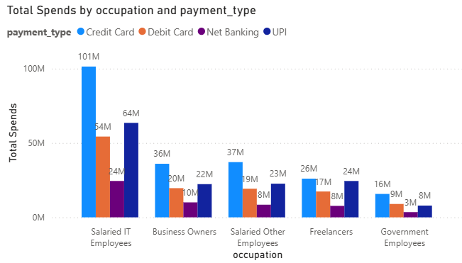
Average Salary & Occupation
Business Owners are a potential group of credit card users.
But they are very less in number among our customers.

Slide 12
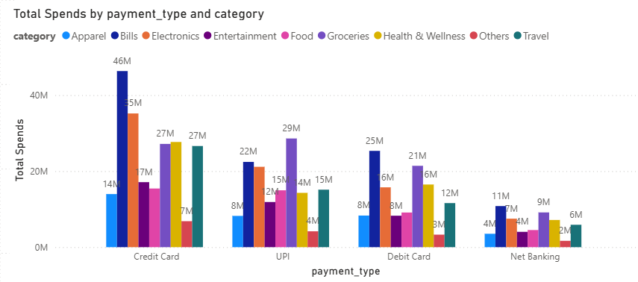
Categories
Credit card is mostly used for paying bills. Secondly for electronics.
Next categories where credit card is mostly used are Health & Wellness, Travel and Groceries.
Groceries are mostly paid using upi than credit card.
Married customers use credit card mostly for paying bills. Unmarried use it mostly for electronics.

Slide 13
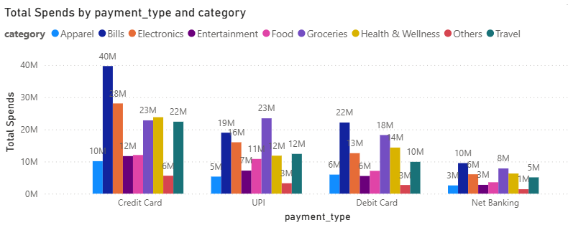
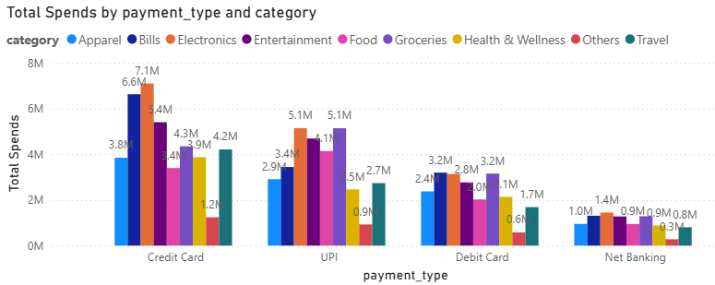
Spending Pattern According to Marital Status
Expenses of Married
Expenses of Unmarried

Slide 14
Insights
Most customers using credit card are IT employees who have average salary between 40k and 70k.
Following credit card usage is by Freelancers and Salaries other employees who have average salary between 20k and 40k.
Credit card is mostly used for paying bills. Secondly for electronics.
Next categories where is credit card is mostly used are Health & Wellness, Travel and Groceries.
Groceries are mostly paid using upi than credit card.
Most customers are married using credit card mostly for paying bills. Unmarried people use credit cards mostly for electronics.
Most customers in general and using credit card are male.

